Slide 1

.
Production Quality Management and Monitoring System
Enhancement The Production lifecycle

Slide 2
Team members
Mohamed Sayed Atwan
Sayed Ahmed Tag-Eldin
Mostafa Mohamed Elborhamy
Mohamed Ezzeldeen Dawod
Ali Yasser Elfarra
Mohamed Khairy Ahmed

Slide 3

Agenda
Problem statement
Project objectives
Expected outcomes
technologies used
Challenges
System Components

Slide 4






Problem Statement:
Manufacturing plants face a continuous challenge in improving product quality and reducing non compliant production. This waste leads to significant financial losses and negatively impacts the plant's overall efficiency. With the increasing complexity of production processes and the variety of variables affecting quality, it becomes difficult for supervisors and manufacturers to identify patterns and influencing factors early enough

Slide 5

Project Objectives
Improve Production Quality by using machine learning models to predict faults and defects at various stages of production.
Reduce Waste by identifying errors and defects in products early and minimizing costs related to non-compliant production.

Slide 6
Manage Big Data using the Data Lake and Data Warehouse approach, allowing the plant to leverage all production data for advanced analytics.
Enhance Preventive Maintenance by determining optimal equipment maintenance times based on data-driven performance analysis

Slide 7

Expected Outcomes
Improved Product Quality : By reducing the number of defects detected during or after production.
Waste Reduction and Cost Savings : Through early detection of potential issues that lead to rejected products

Slide 8
Increased Equipment Efficiency : Continuous monitoring of equipment performance to ensure optimal operation and reduced downtime.
Enhanced Operational Efficiency : Improving manufacturing processes and minimizing production downtime, leading to higher competitiveness for the plant

Slide 9

Technologies Used :
• Microsoft Azure Data Lake for storing unstructured data from all factory systems.
• Azure Synapse Analytics (Data Warehouse) to organize and analyze structured data from different sources And Making ML Modeling.
• Power BI for interactive dashboards and reports to visualize performance.
• Microsoft SQL Server for managing structured data related to product quality and equipment performance.

Slide 10

Challenges:
Data Diversity
Big Data Analysis
Fault Prediction
Preventive Maintenance

Slide 11

Data Diversity
Collecting diverse data from different production lines, including environmental data (temperature, humidity, speed, pressure) and mechanical performance data from equipment.

Slide 12

Big Data Analysis
Handling large volumes of structured and unstructured data and analyzing them accurately to extract predictive insights.

Slide 13

Fault Prediction
Developing accurate predictive models using machine learning to analyze production data and detect potential issues before they occur
.

Slide 14

Preventive Maintenance
Identifying optimal maintenance schedules for equipment based on performance data to prevent breakdowns that could halt production.

Slide 15

System Components
1- Data Collection and Infrastructure Design Implement Data Warehouse
2- Machine Learning and Predictive Analytics Development
3- Preliminary Analysis using power BI

Slide 16

1- Data Collection and Infrastructure Design Implement Data Warehouse
Create a Data Lake using Microsoft Azure Data Lake to store all raw, unstructured data from sensors and plant monitoring systems.
Design a database using SQL Server to store structured data such as product quality and equipment performance data

Slide 17
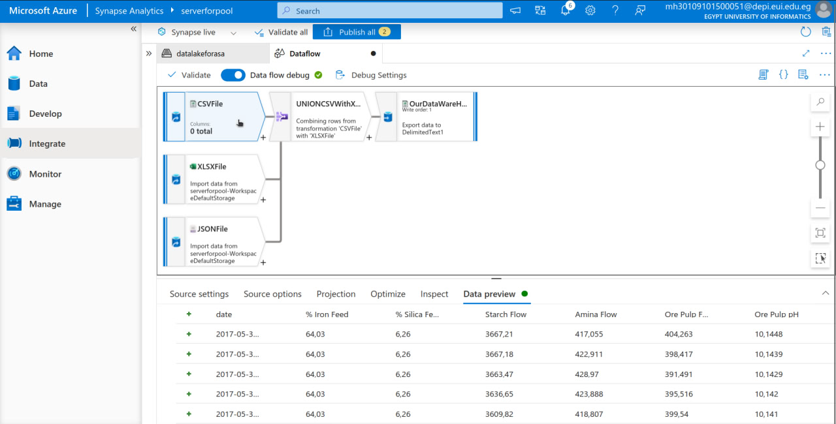

Slide 18
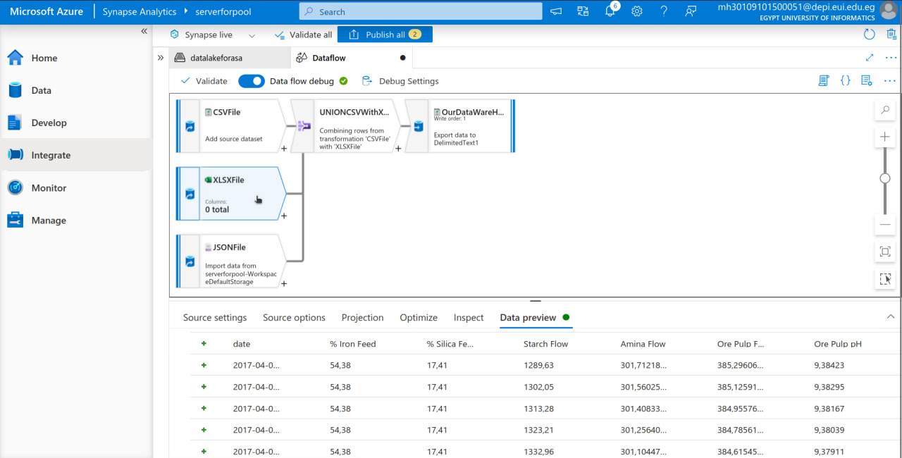

Slide 19
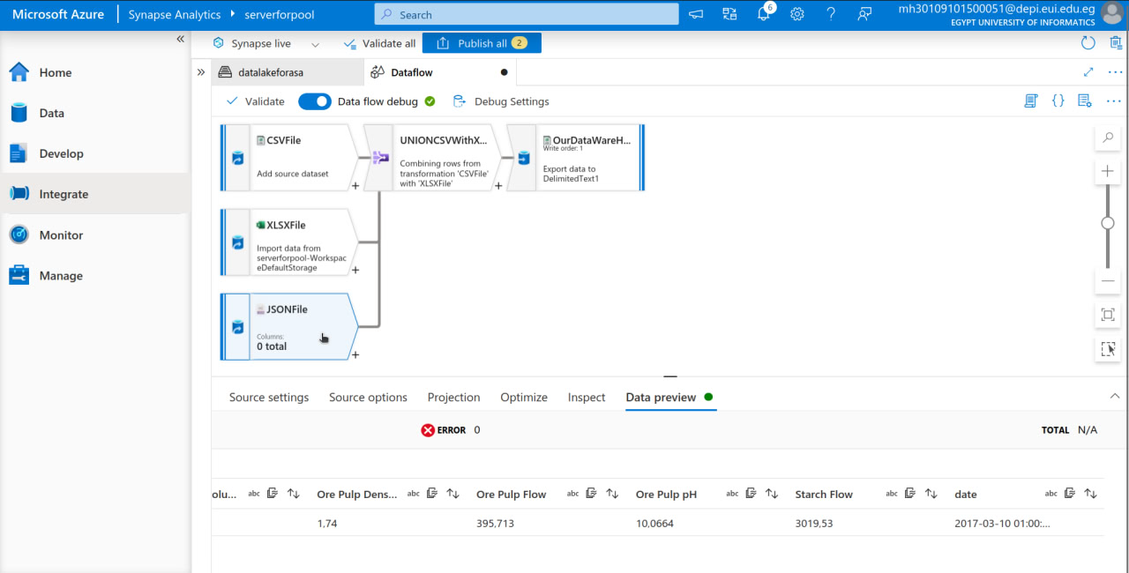

Slide 20
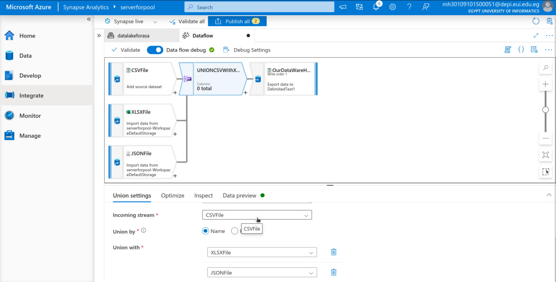

Slide 21
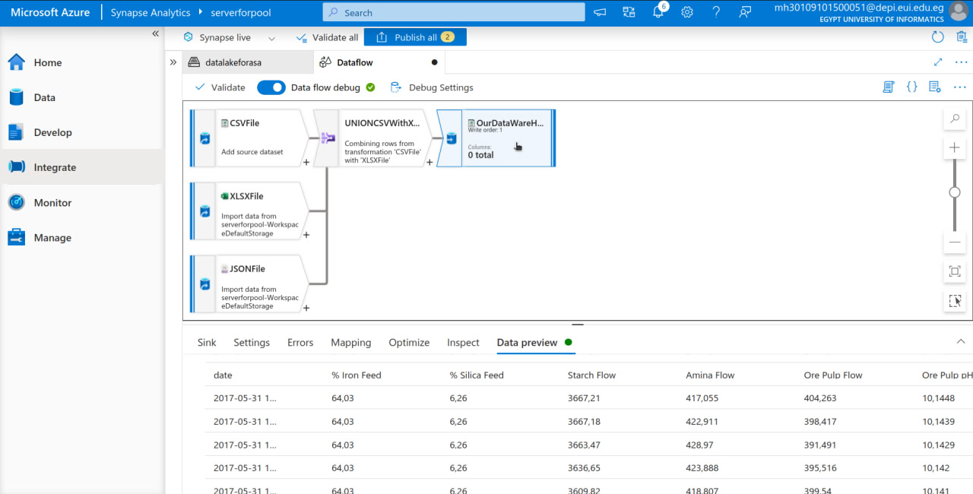

Slide 22
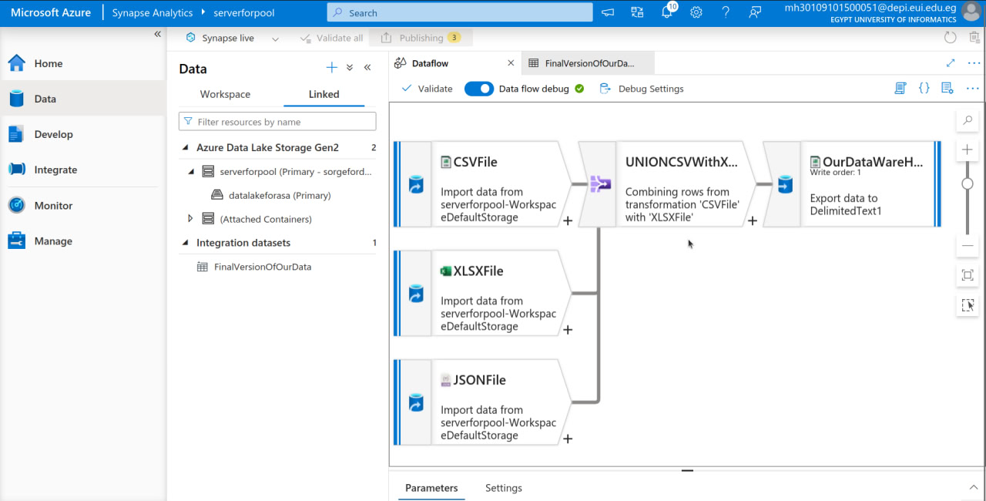

Slide 23
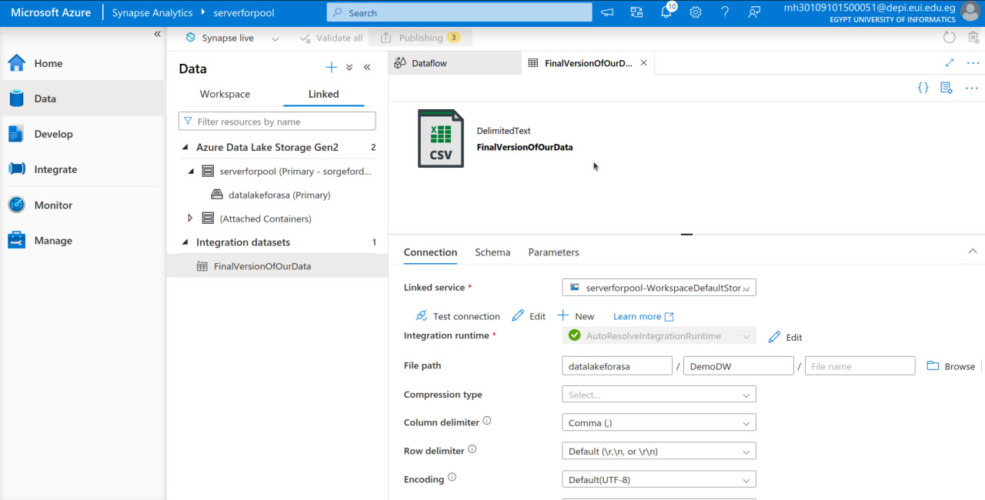

Slide 24
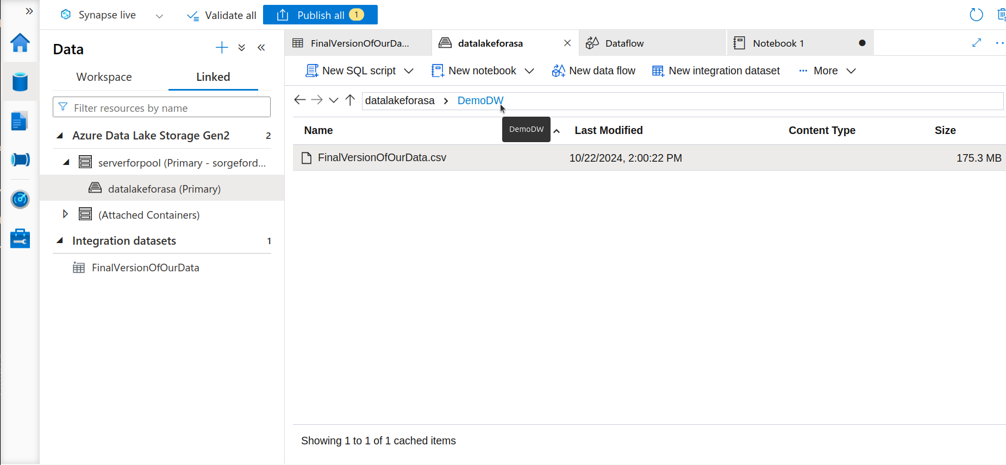

Slide 25

2- Machine Learning and Predictive Analytics Development
Develop machine learning models with Azure Machine Learning to analyze large datasets and detect patterns leading to defects.
Integrate and Analyze Variables: Study the impact of environmental factors on production quality and suggest improvements to the process

Slide 26
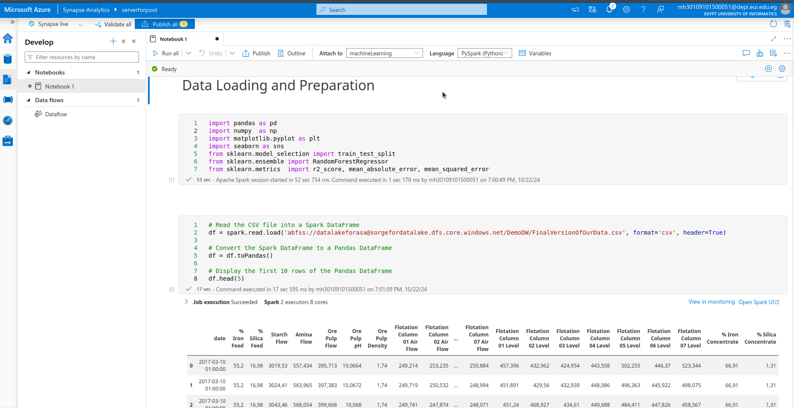

Slide 27
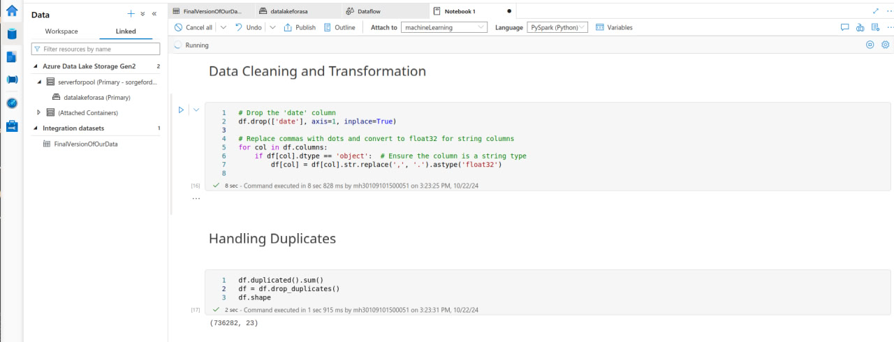

Slide 28
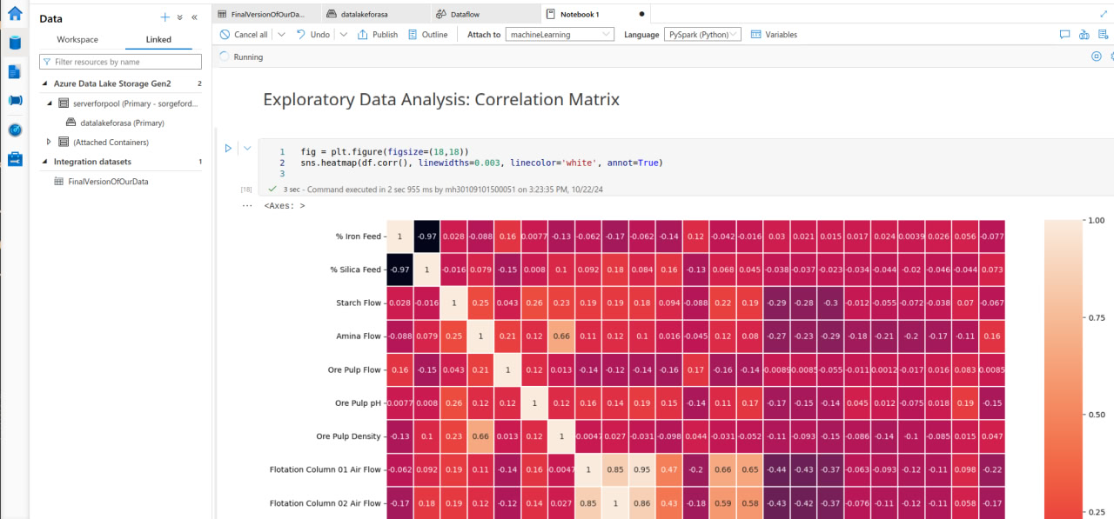

Slide 29
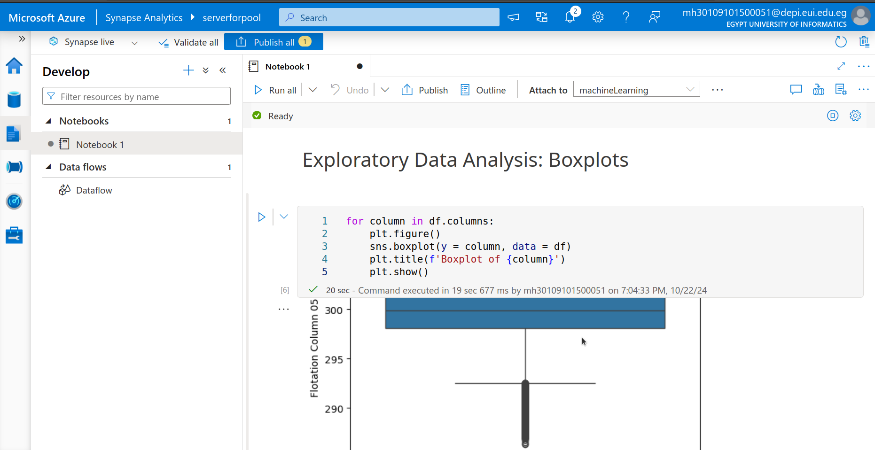

Slide 30
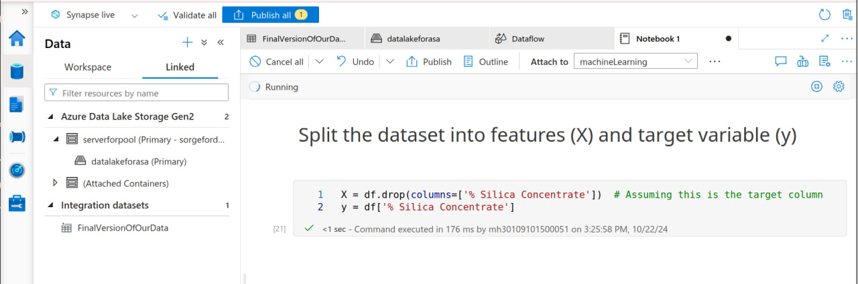
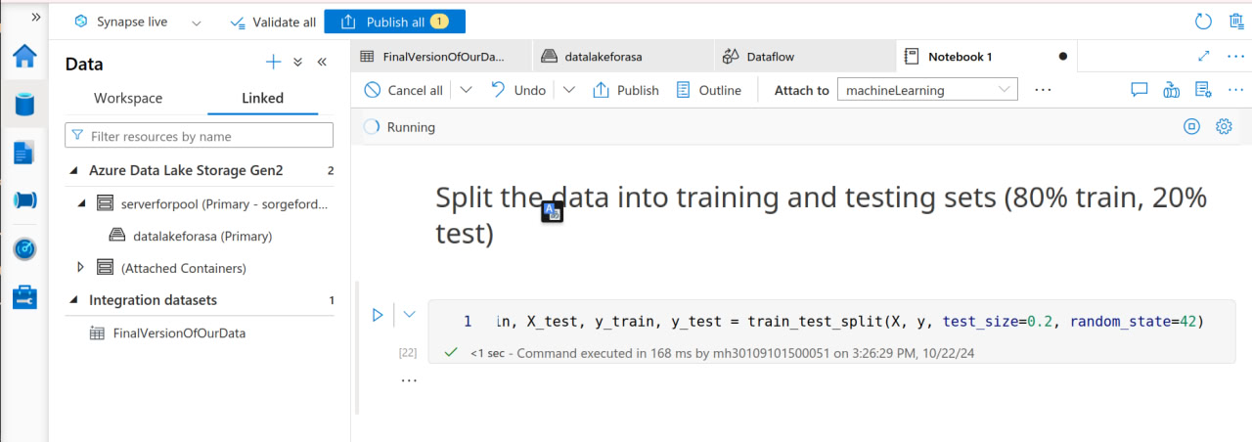

Slide 31
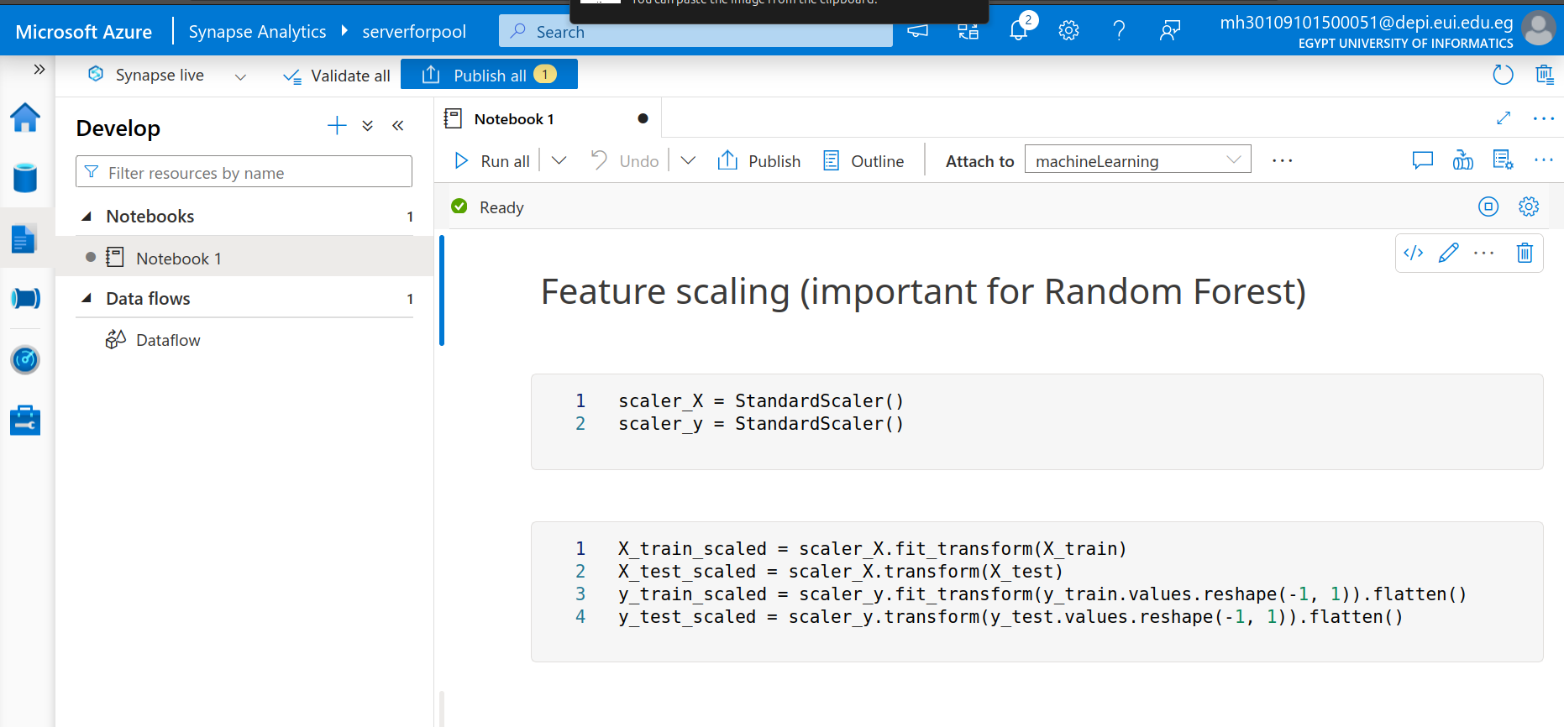

Slide 32
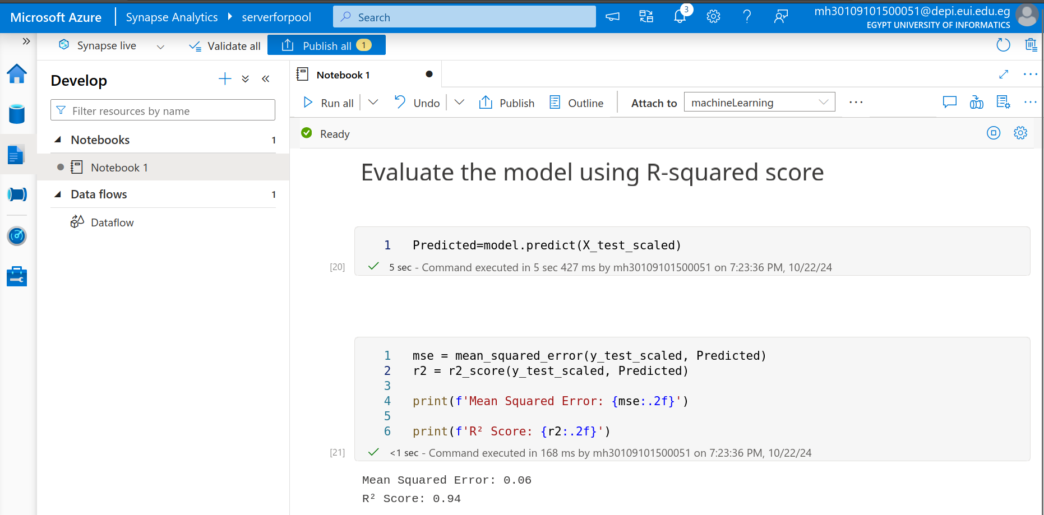

Slide 33

3-Preliminary Analysis using power BI
Conduct initial data analysis with Power BI to create visual reports on defect rates and equipment performance

Slide 34
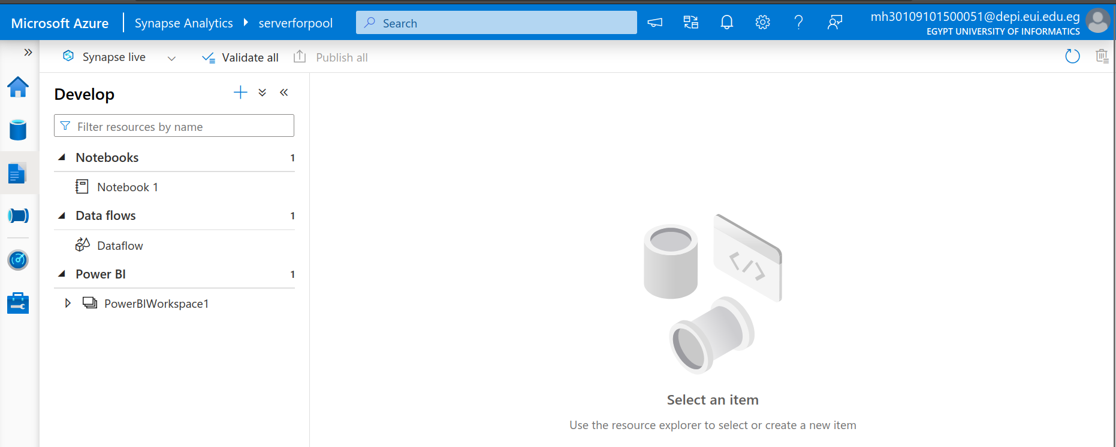

Slide 35
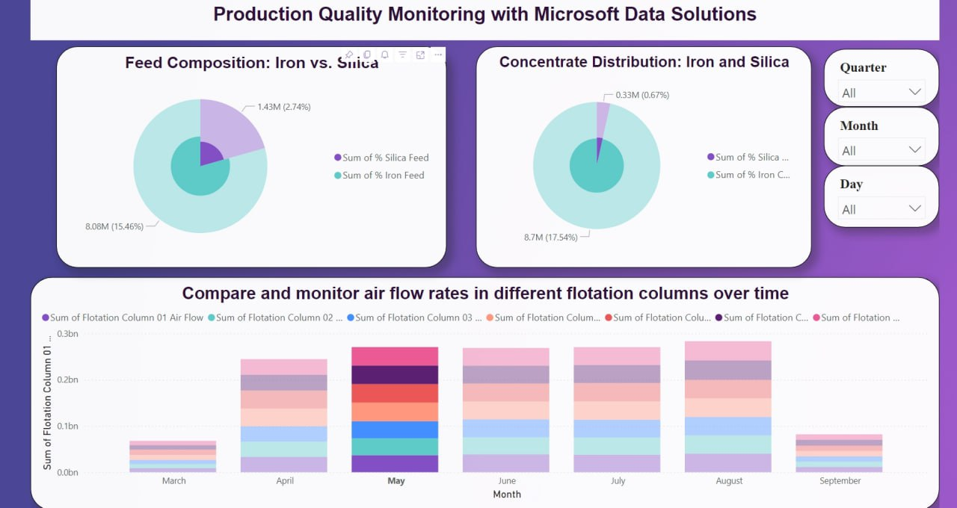
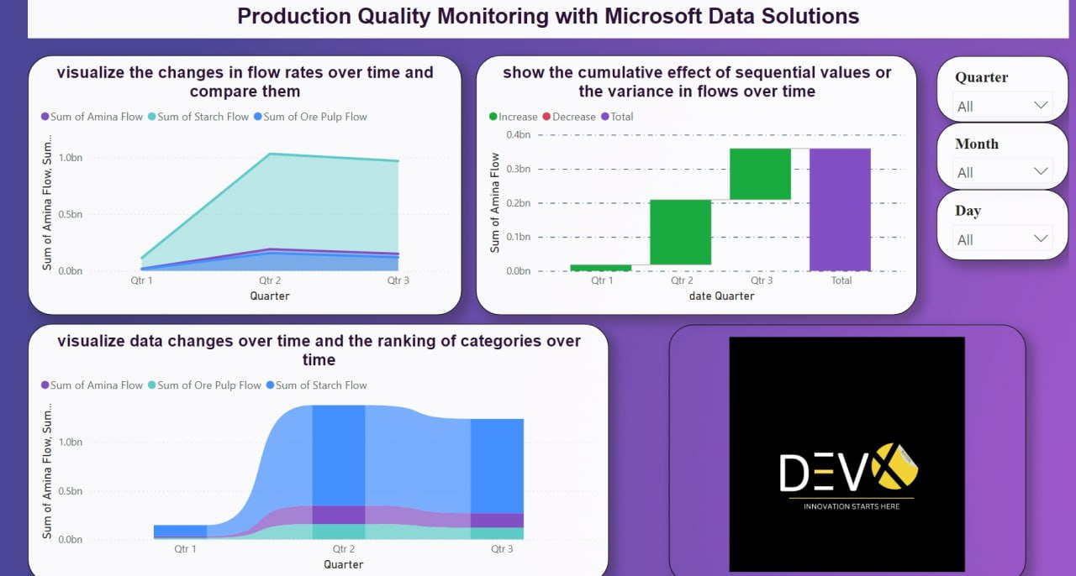
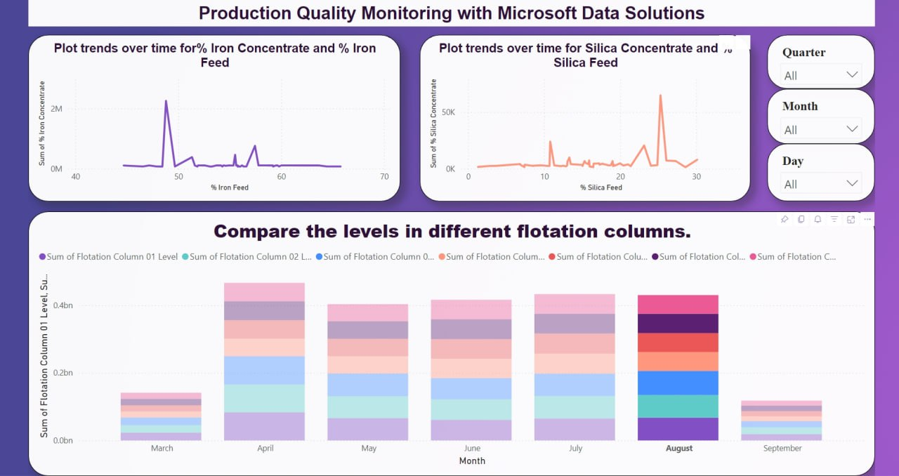

Slide 36
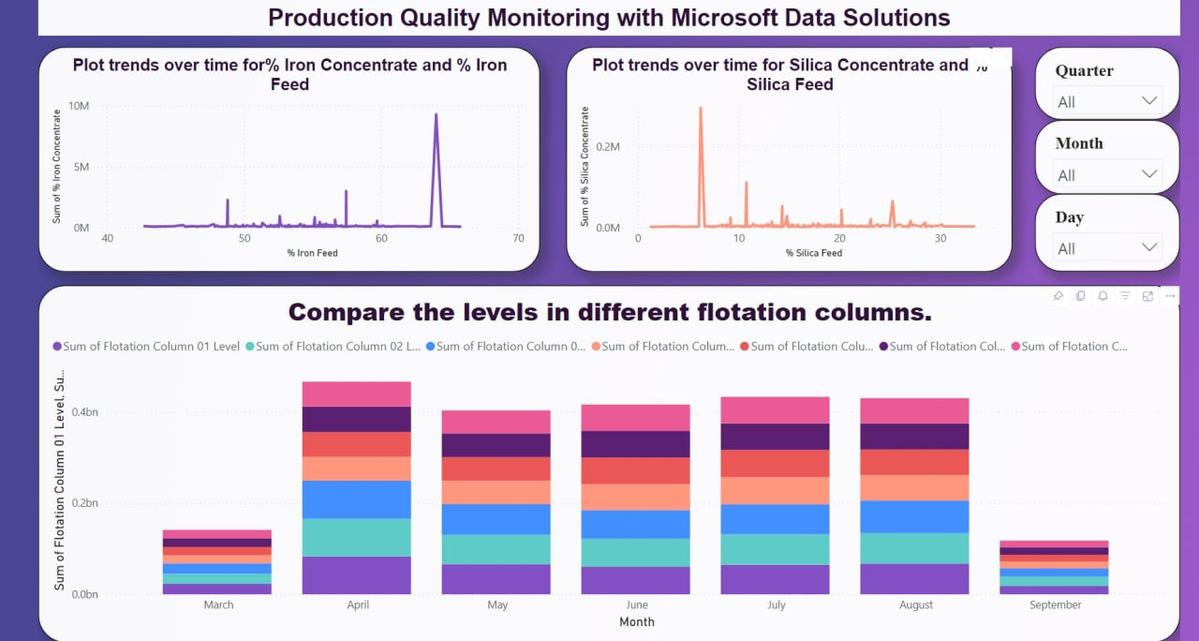
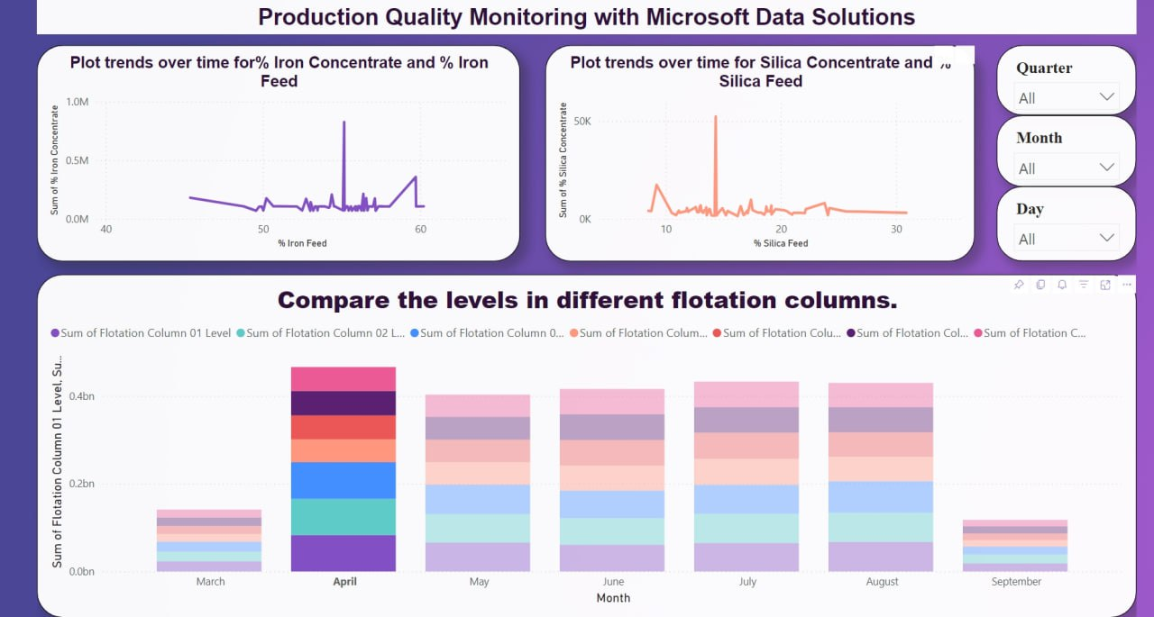

Slide 37


